Slide 1

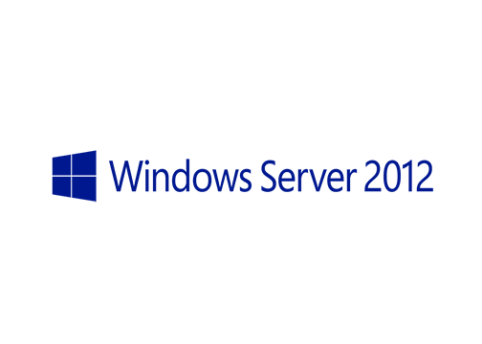
MegaSeries
Cluster aware updating with Powershell

Slide 2
Intro
New feature in Windows Server 2012
This is a cool feature which can help you perform patches on your clusters without too much stress
Each node of the cluster is put in maintenance mode and updated while the other ones host the cluster resources
As a node is done with the updates it starts working normally and another one takes its place

Slide 3
Operation modes
Self updating mode (the update process is implemented as a cluster role on one of the nodes)
Remote updating mode (the update process is coordinated from another machine outside the cluster)

Slide 4
Important note!
If you will be using CAU please make sure that there are no other systems that schedule automatic updates on your cluster nodes like WSUS or SCCM
If CAU takes the updates from WSUS your cluster nodes should only be configured to point to the update server and that’s all; no automatic update settings please!

Slide 5
https://www.youtube.com/channel/UCcZ-jLbPwNr8E_v9-65n8Iw https://github.com/itknowledge4

